Slide 1

Introduction To Ray A Distributed Computing Framework
Bhagirathi Hegde
Sarath Srinivas

Slide 2
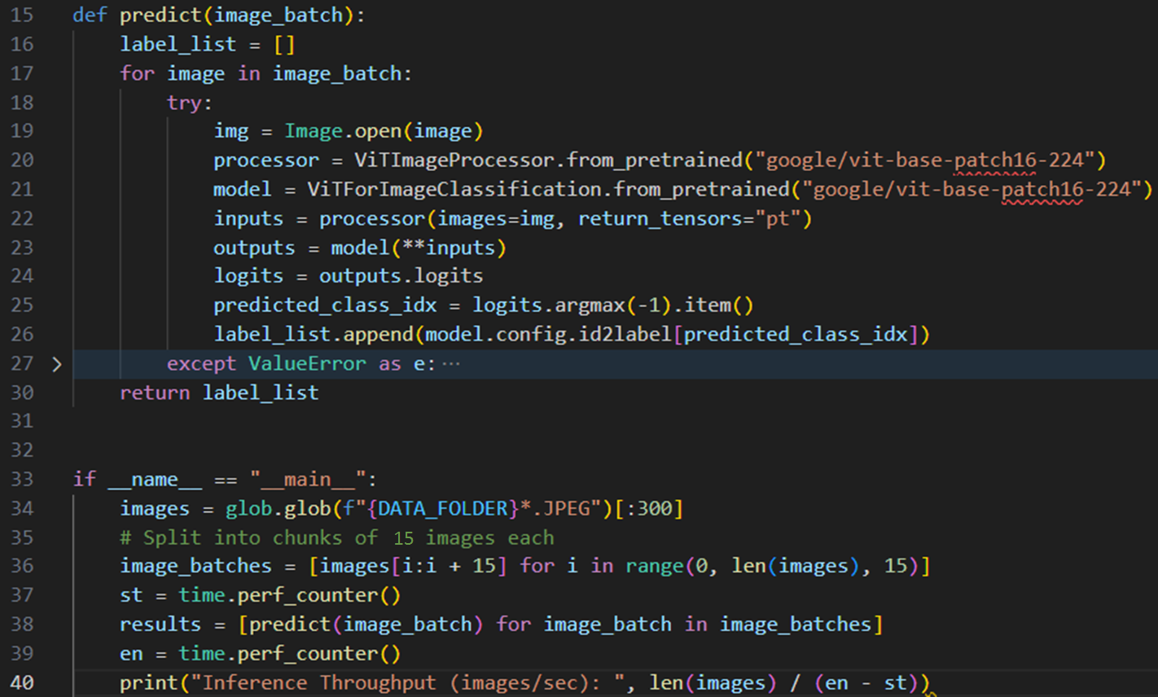
Simple Batch Inference

Slide 3
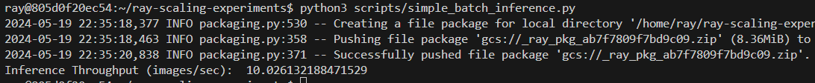
Program Execution
Single processor
Multiprocessing on 4 cores
Ray cluster with 16 cores (multiple machines)
How to scale?
Notes:
Single processor – 6.66 mins for just 300 imgs
Multiprocessing – 2.3 mins
Ray – 0.5 mins
Apply_async from Multiprocessing library used for local python multiprocessing

Slide 4

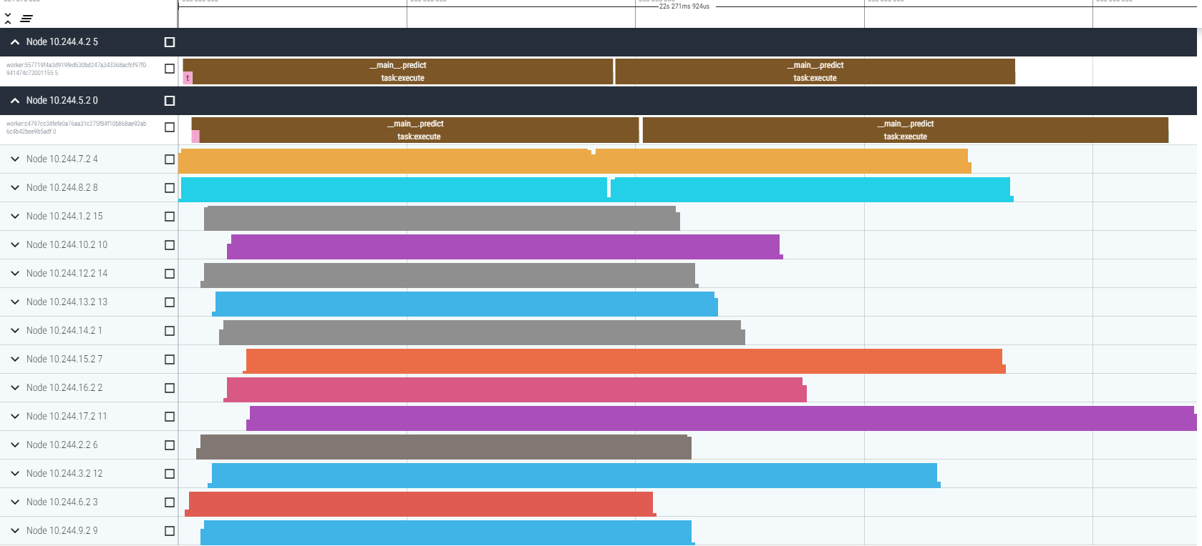
Distributed Execution
Ray distributes tasks across a cluster of machines, accelerating workflows
Tasks in Ray can be any arbitrary functions that are executed asynchronously on separate workers
So multiple tasks can execute simultaneously
1 task : 15 imgs
300 imgs in total
So, 20 tasks distributed across 16 cores

Slide 5
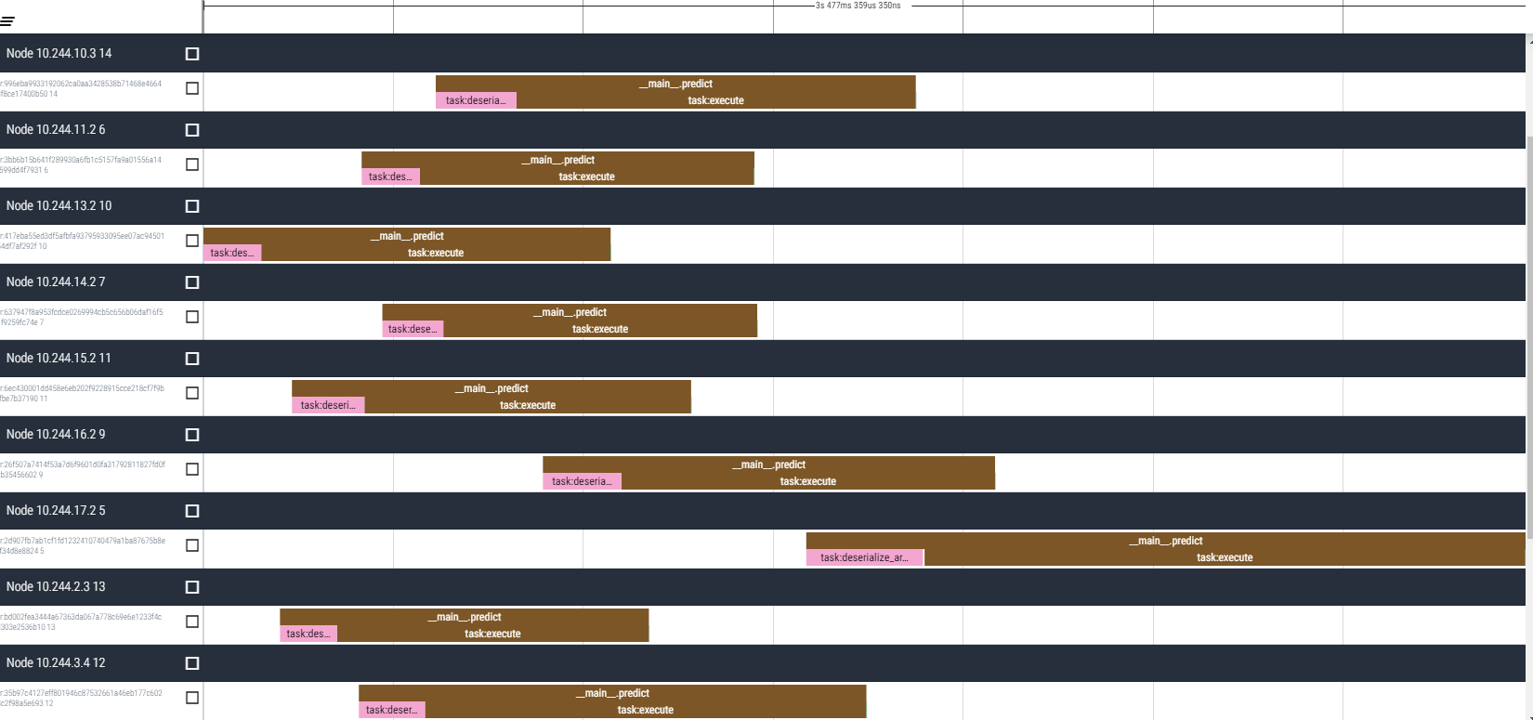
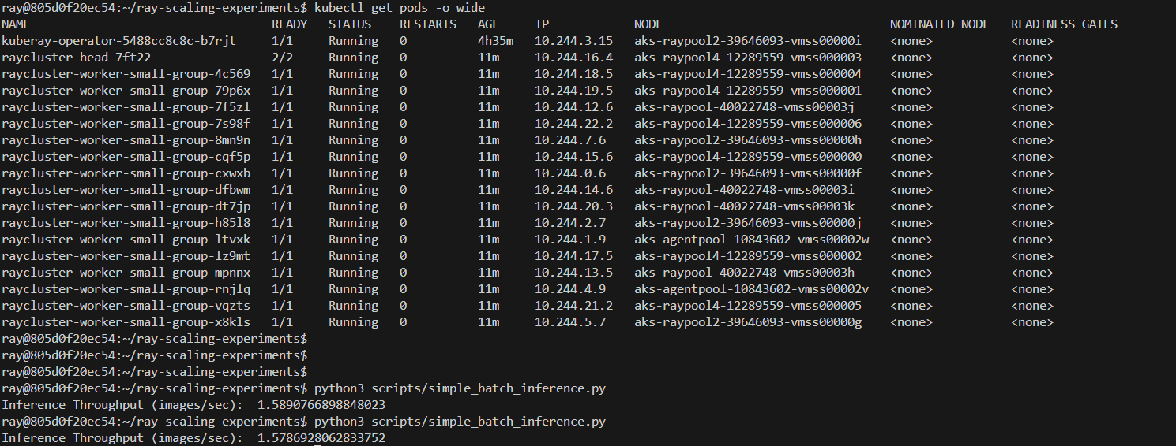
Distribution overhead
Amortized for big enough tasks

Slide 6
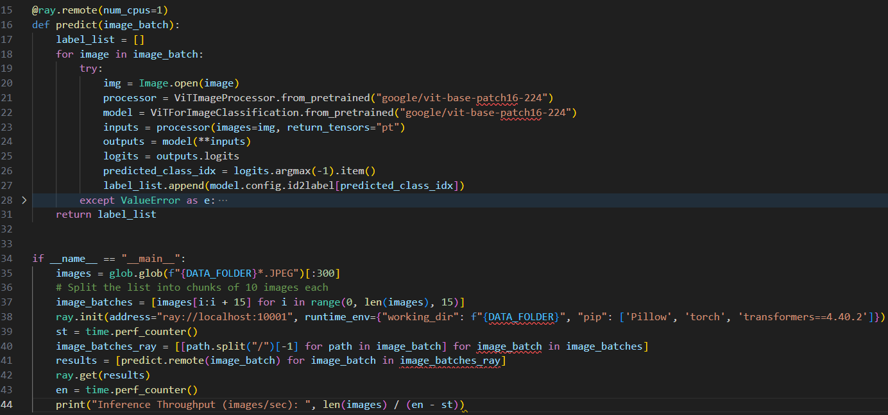
The only code changes
ray.get collects results from all workers; blocks until all complete
Async invocation of tasks; each execs on a separate python worker

Slide 7
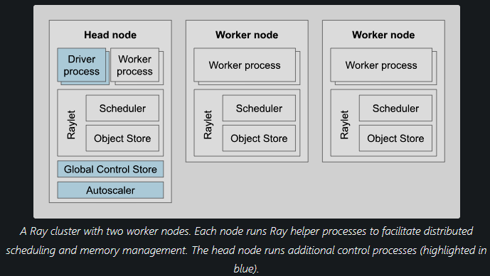
Ray cluster
Notes:
A Ray cluster consists of a single head node and any number of connected worker nodes

Slide 8
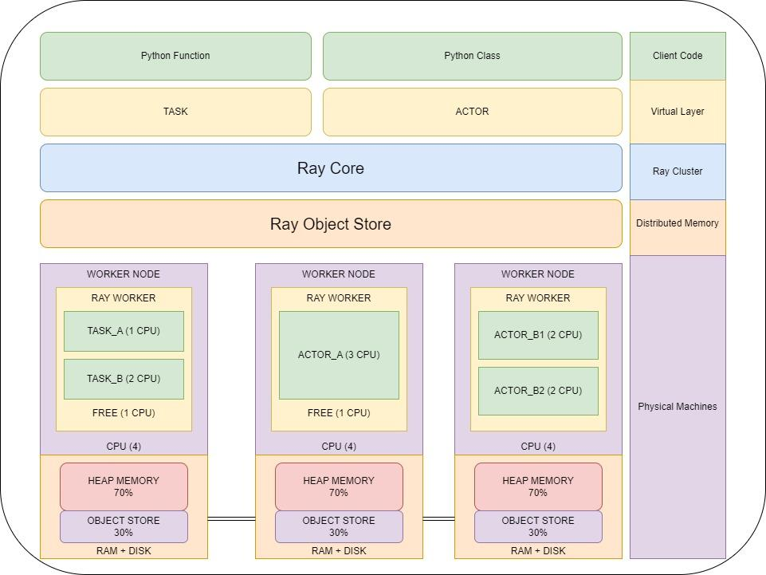

Slide 9
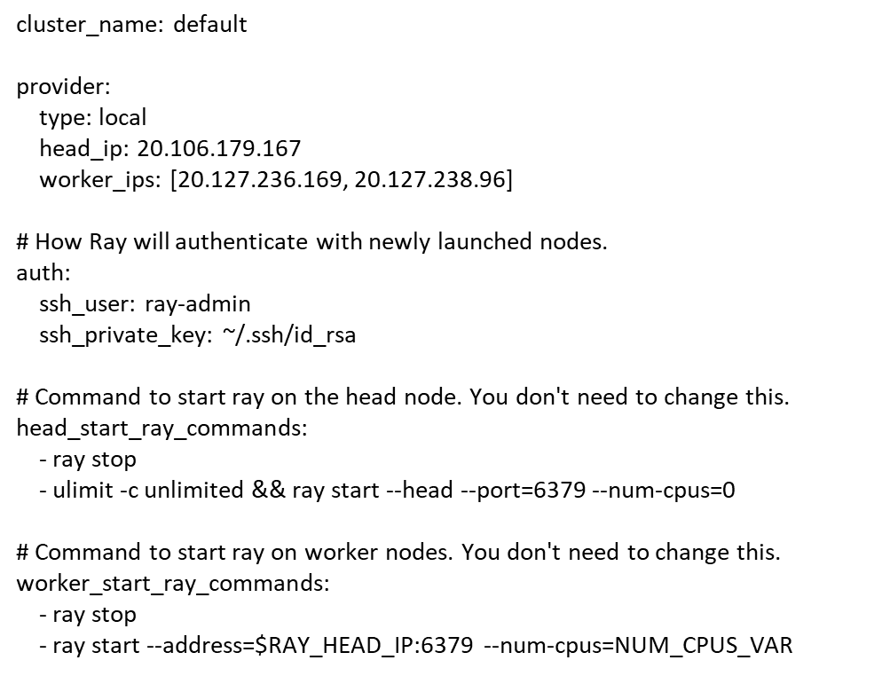
Starting a ray cluster is very simple
cluster.yaml
ray-admin@ray-head-vm:~/ray-scaling-experiments/deploy$ ray up cluster.yaml

Slide 10
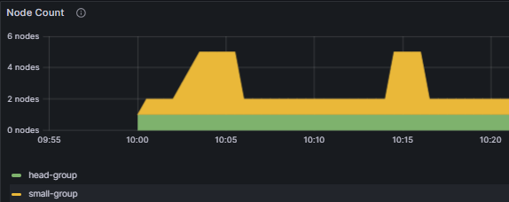
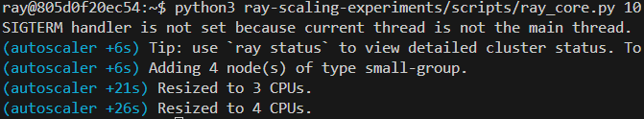
Autoscaler with kuberay
Ray scales up and down resources dynamically based on requirements/requests

Slide 11
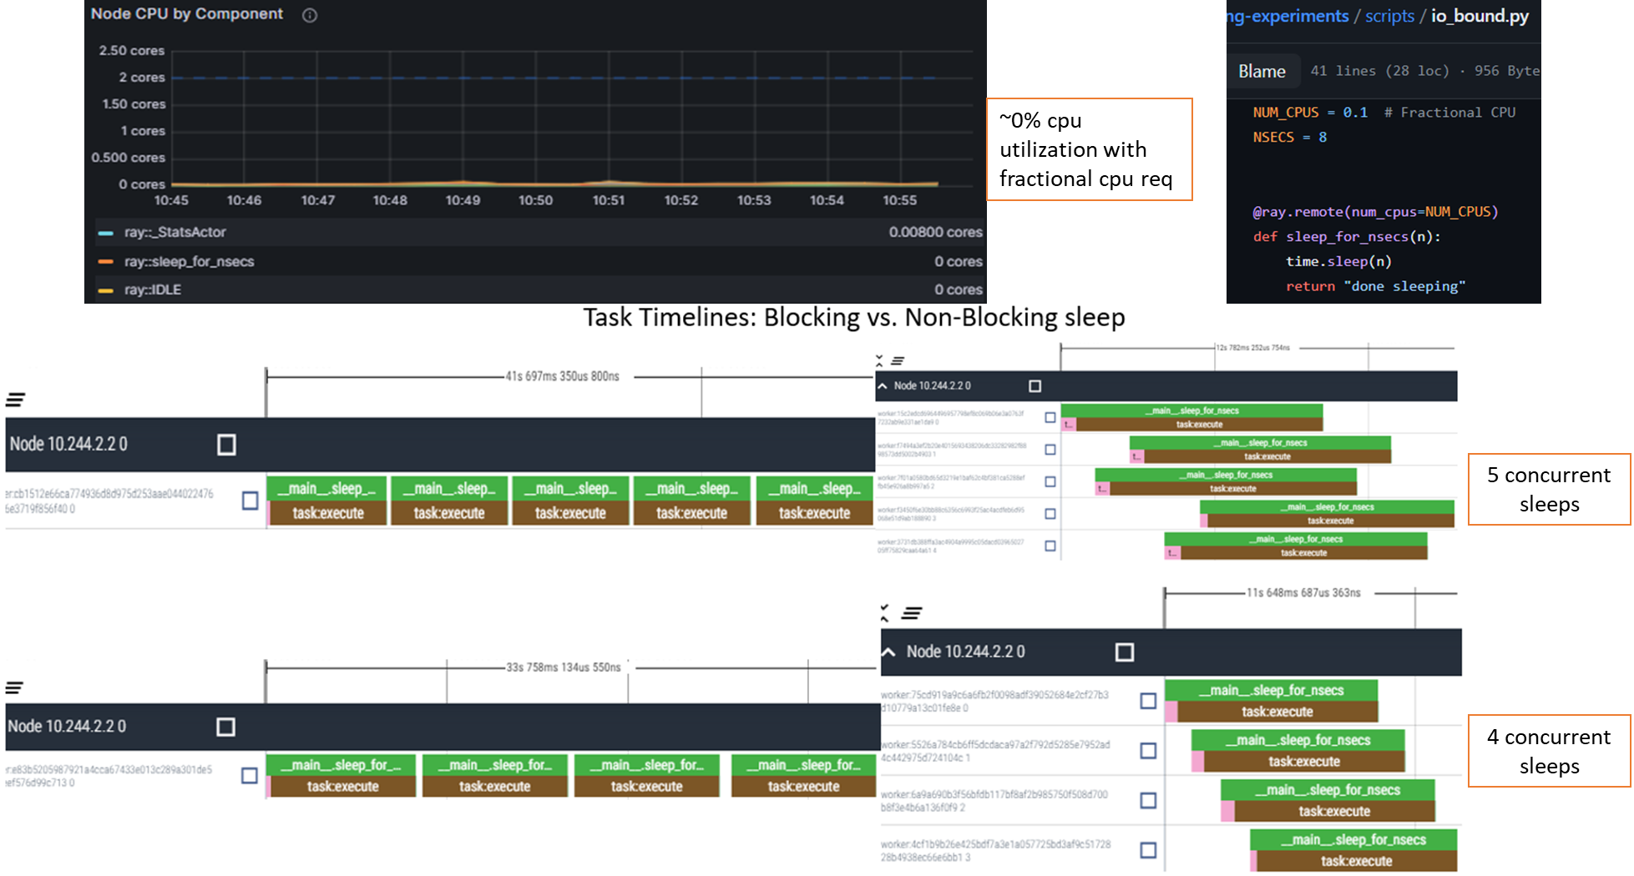
Run Hybrid Workloads
By using fractional CPU for I/O Bound tasks

Slide 12


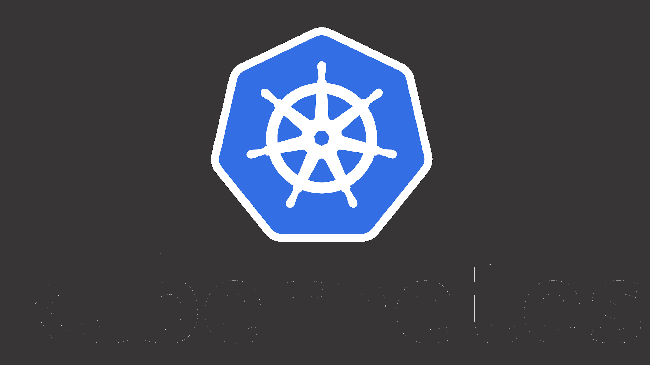

Benefits of Ray over other distributed computing options
Python-centric
Flexible and general-purpose
Scales efficiently
Optimized for real-time and low-latency applications
vs
MapReduce centric, dataflow-based – limited task flexibility
Natively scala
Complex, Limited task management
Mostly Data Parallel/ Mapreduce oriented
Notes:
Spark - support for Python is somewhat secondary and may come with performance trade-offs

Slide 13
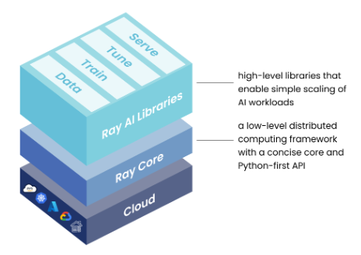
Ray Frameworks
Notes:
Ray Train abstracts away the complexity of setting up a distributed training system.
Ray Serve: A production-ready model serving library built on Ray for deploying machine learning models as web services.

Slide 14
Summary
Ray is a distributed computing framework for scaling up Python applications.
Benefits:
Enables parallel execution of tasks across multiple machines or cores.
Simplifies building scalable and fault-tolerant applications.
Offers a user-friendly API for distributed computing.
From program on laptop to a high-performance distributed application with relatively few additional lines of python code

Slide 15
Resources
Ray documentation
Our GitHub repo

Slide 16
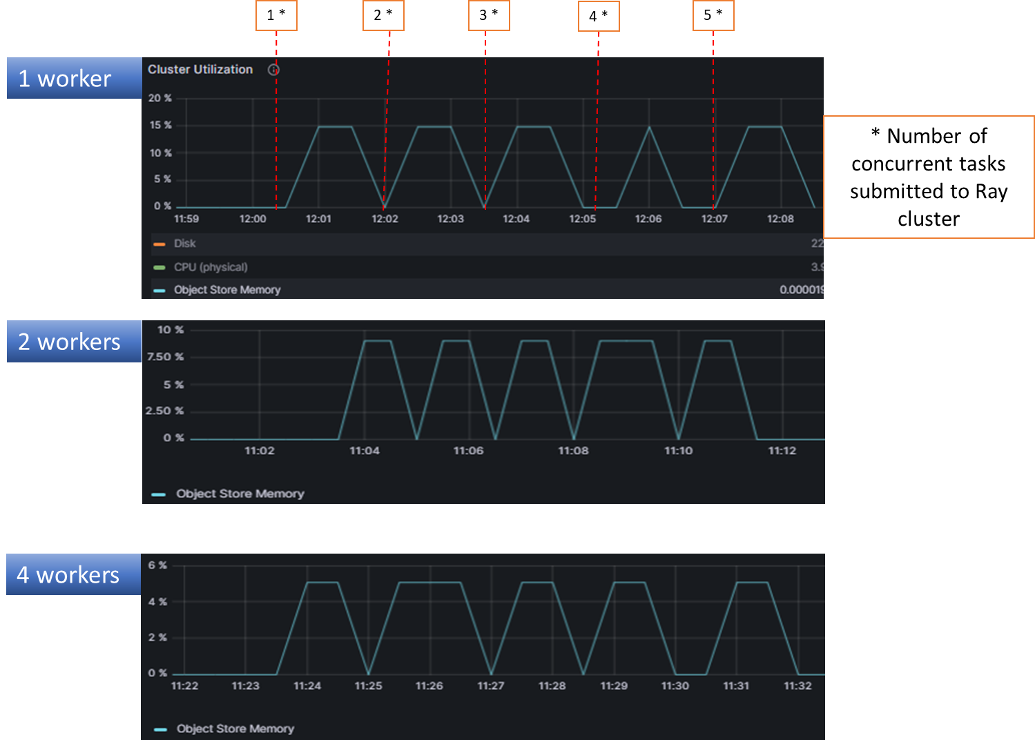
Object Store in action

Slide 17
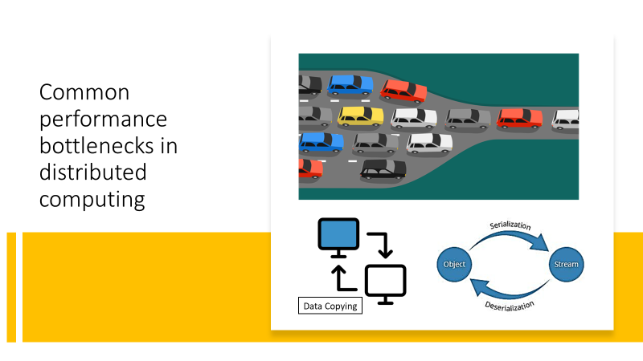
Plasma Object Store
Immutable objects in shared memory
1 object store per node; zero-copy access for workers on same node
Data written to another node’s object store only when requested by another task
Notes:
Plasma Object Store designed to address common perf bottlenecks

Slide 18
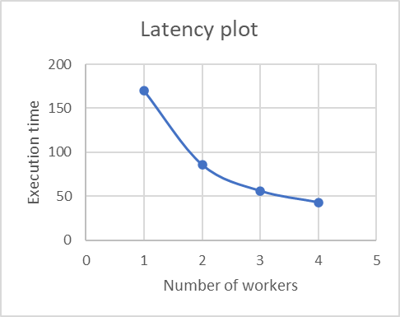
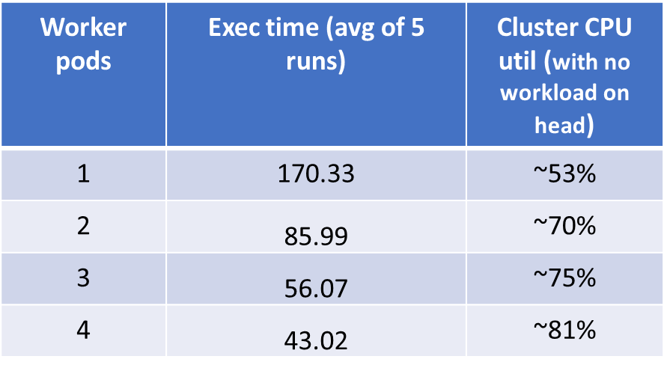
Effective Scaling
Doubling of workers halves the execution

Slide 19
Core Concepts - Actors
Preserve state; useful for building fault-tolerant applications

